Slide 1
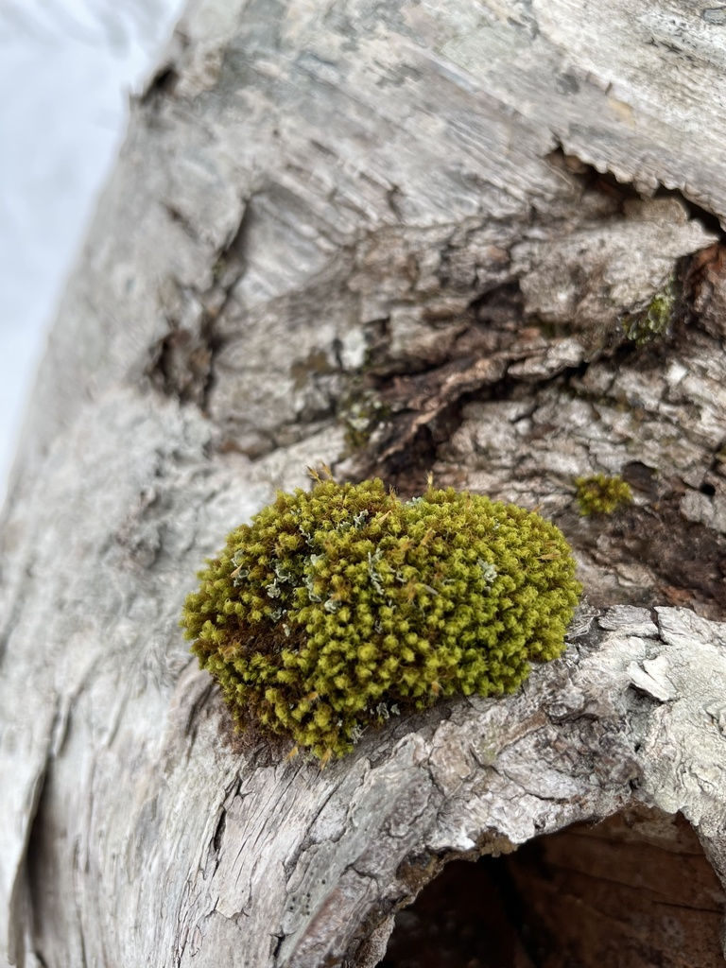
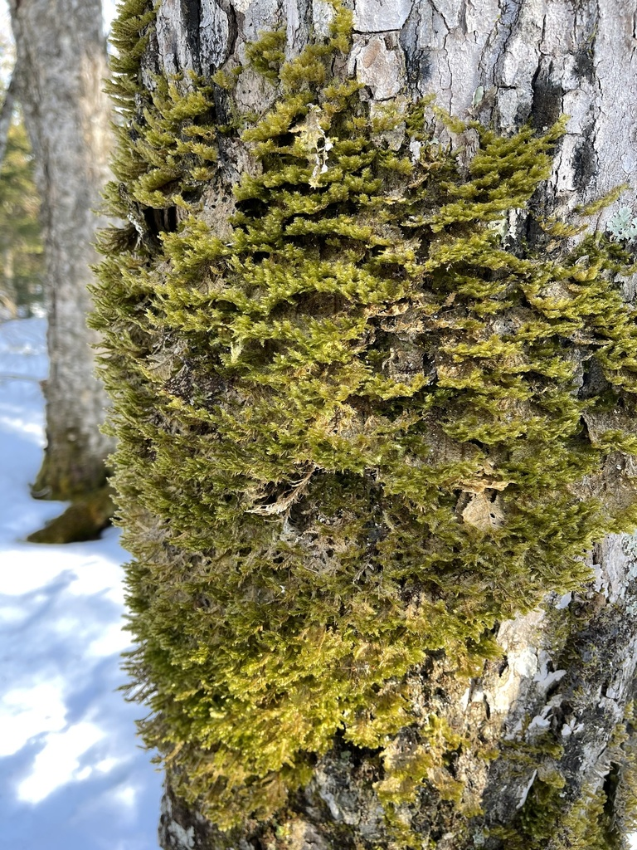
What are mosses and how can we harvest them safely?
“Mosses” are:
non-vascular plants (i.e. Bryophytes)
They lack seeds
Grouped into three taxonomic groups
Liverworts
Hornworts
Mosses
Dr. Katherine Jones, Biology, CBU

Slide 2
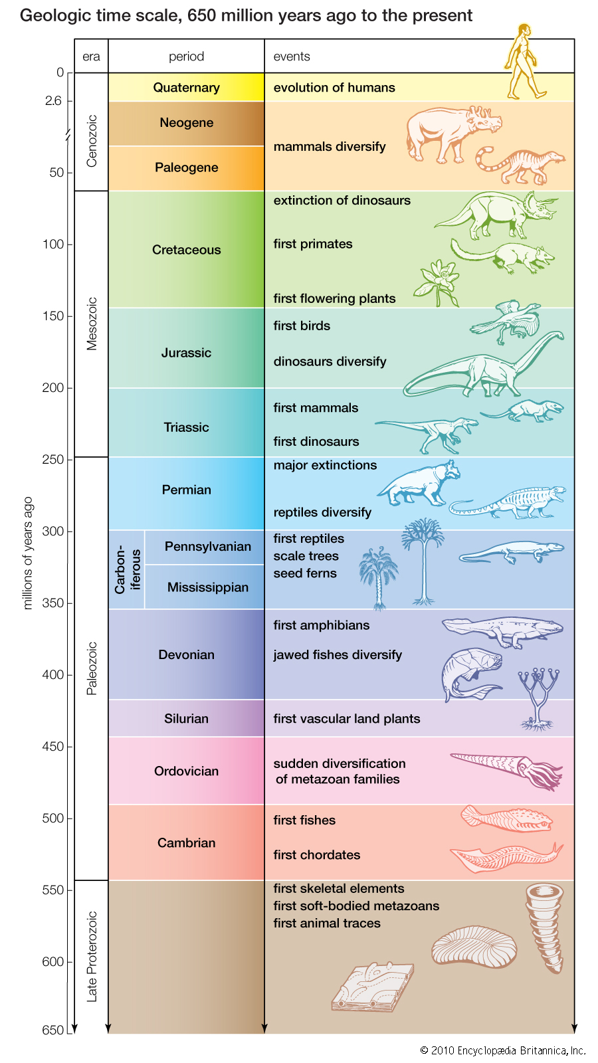
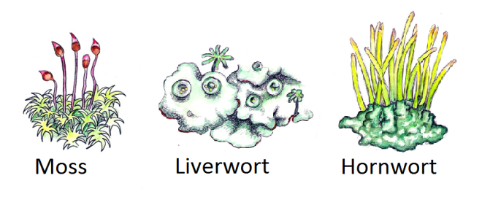

Slide 3
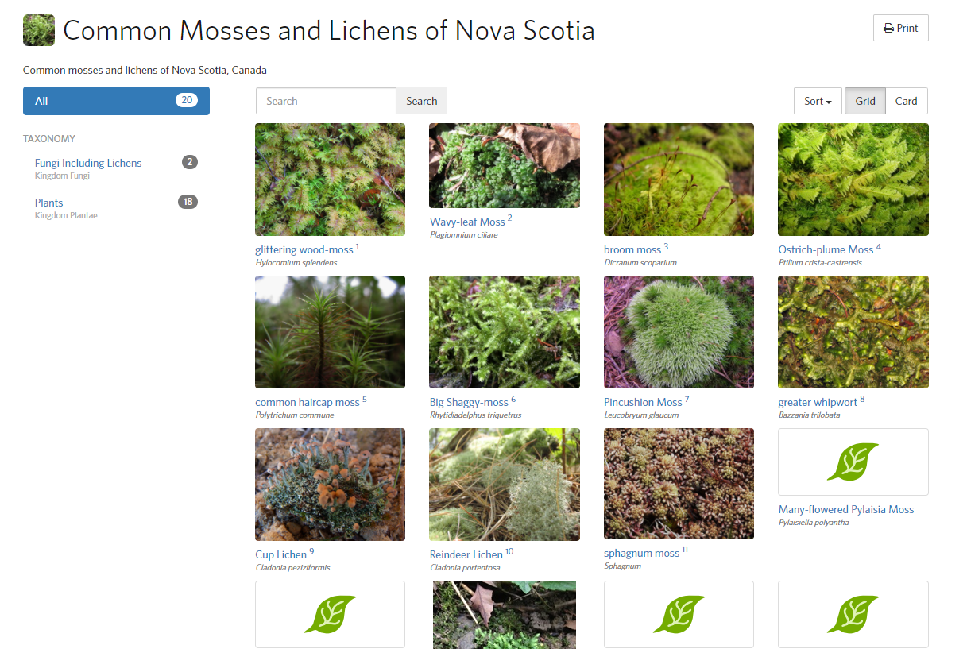

Slide 4
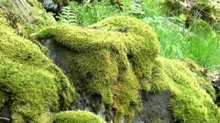
Mosses (Bryophyta)
Most closely related to vascular plants
Usually form a spongy mat
Photosynthesis in small stem-like and leaf-like structures
Notes:
Mosses are the bryophytes most closely related to vascular plants.
We are going to focus on them as our representative bryophyte.
Note, the name Bryophyta refers only to one phylum, but the informal term bryophyte refers to all nonvascular plants.

Slide 5
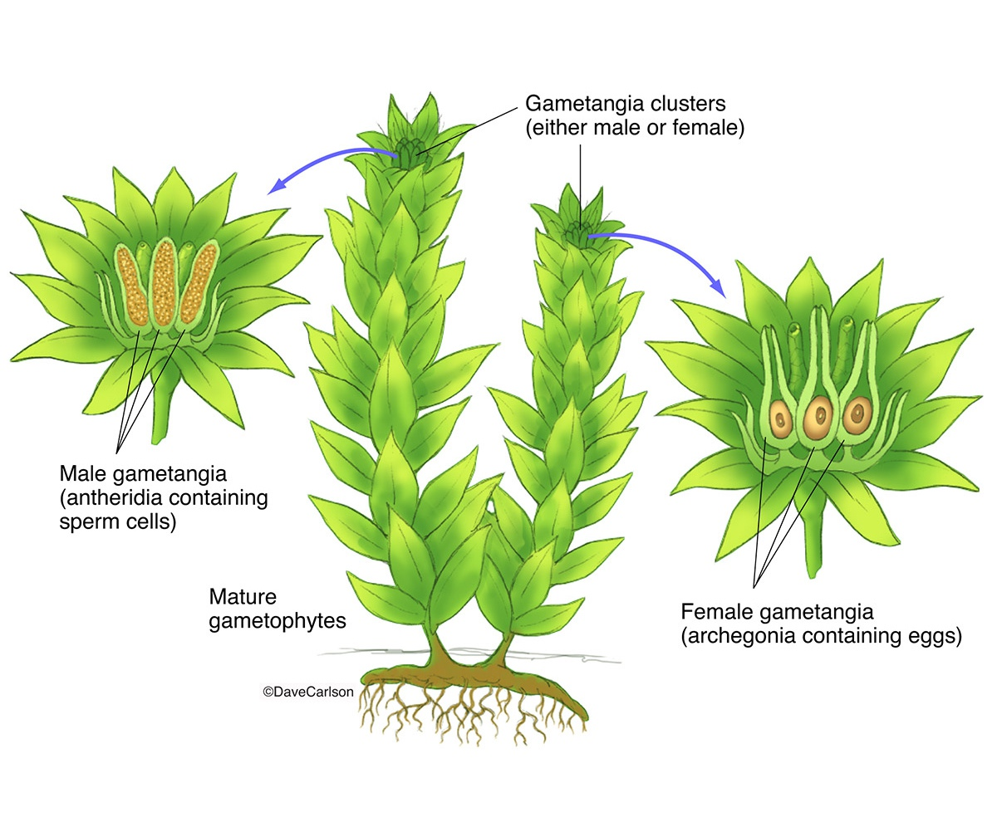
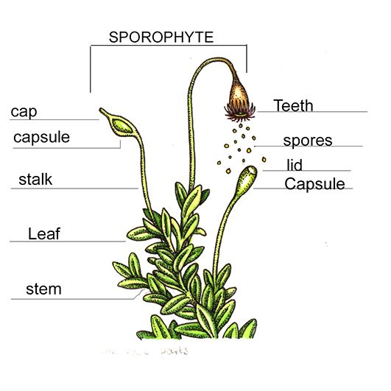
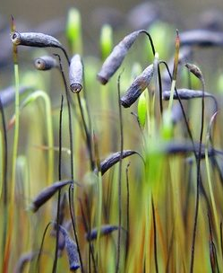
Adaptations for life on land
1. Waxy cuticle - Prevents drying out
2. Fertilized eggs - protected within parent tissue

Slide 6
Still need wet habitats
1. no vascular tissue
Xylem, if present, lack lignin
Rhizoids, not roots → need to always be wet
Lack woody tissue for support
- Therefore always low to the ground (like carpet)
Notes:
Generally, bryophytes lack vascular tissue (no phloem or xylem). This means that any transport of water and nutrients, both minerals and photosynthetic products throughout the plant must occur by diffusion between cells or through capillary action. Because of this, bryophyte gametophytes are only a few cells thick. This places all cells close to water and dissolved minerals that diffuse across the tissue. The “leaves” of most mosses lack a cuticle and are only once cell thick, features that enhance water and mineral absorption from the moist environment.
In this slide you can see a cross section of the moss stem. Note the leaves coming off the stem. There are three regions in this stem, A single outer layer of cells forms the epidermis. In the very centre of the stem is a region of cells called the central cylinder, and in the region between the central cylinder and the epidermis lies the cortex.
Some bryophytes do have specialized tissues to conduct water, but the cell walls lack lignin, a coating characteristic of the xylem in vascular plants that helps to provide support. The gametophytes of mosses and some liverworts are more “leafy” because they have stemlike structures that bear leaflike appendages.They are not true stems or leaves because they lack lignin-coated vascular cells.
Bryophytes are anchored by tubular cells or filaments of cells, called rhizoids. Rhizoids are not roots – they lack specialized conducting cells and do not play a primary role in water and mineral absorption.

Slide 7
Harvesting Etiquette
Take only what you need
Take a little bit of the soil or decaying tree bark along with the moss
Minimize disturbance
Great for projects: Make an Earth Moss Ball, and build a Class Terrarium

