Slide 1

LICHEN
To accompany Grade 3-5 Science Lichen Hunt

Slide 2
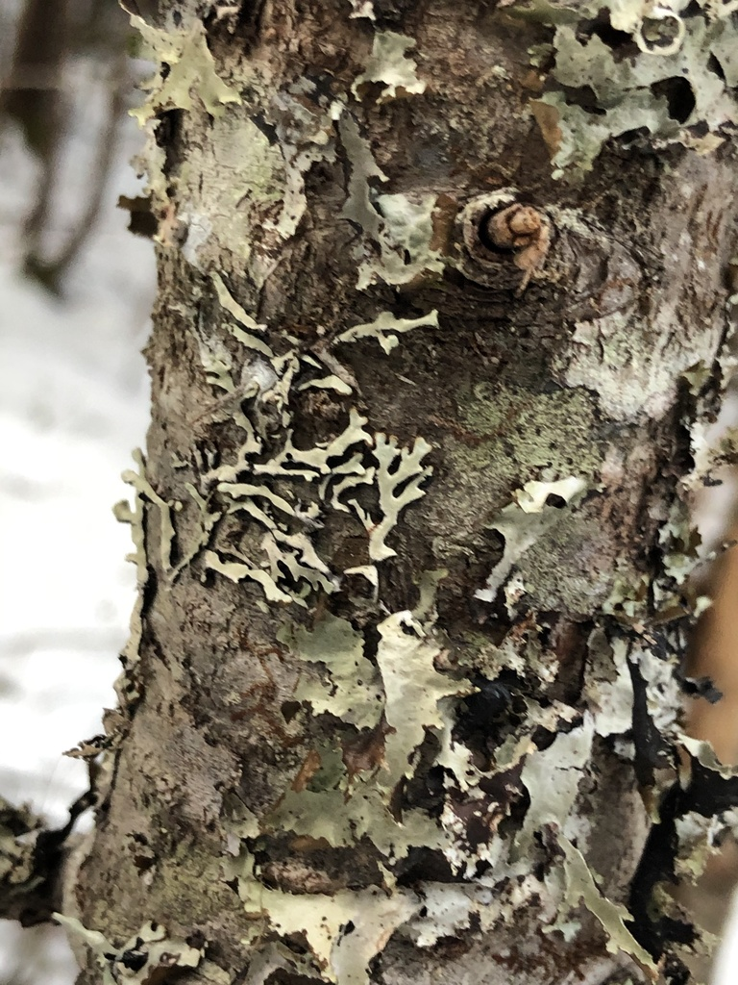
What are lichen (LY-ken)?
Lichen are really cool!
They are made up of at least two different organisms
  usually a fungi + an organism that is photosynthetic
  A fungi belongs to the Kingdom Fungi which include mushrooms (all fungi eat by decomposing stuff)
  Photosynthetic organisms produce their own energy from sunlight (like plants or algae)

Slide 3
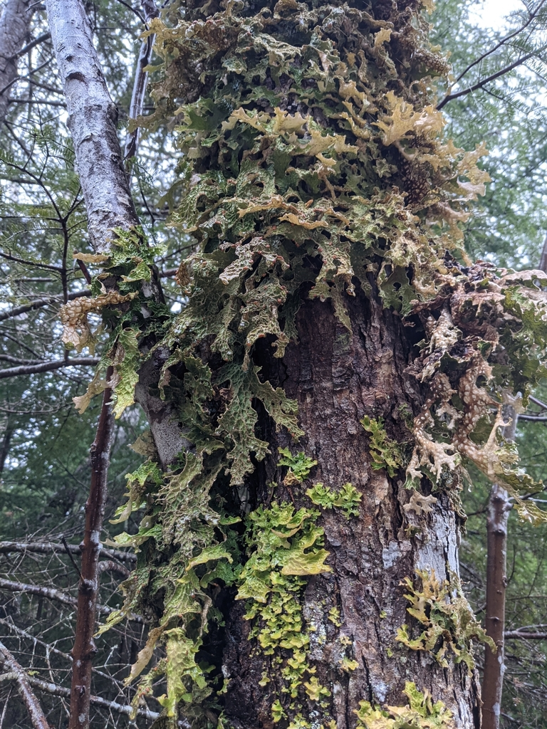
SYMBIOSIS (sim-bee-OW-suhs)
Both the fungi and the photosynthesizer benefit from their partnership → mutual symbiosis
Good partners for the fungus species include:
  ‘Algae” or “Cyanobacteria”
Some Fungi are comprised of 3 species!

Slide 4
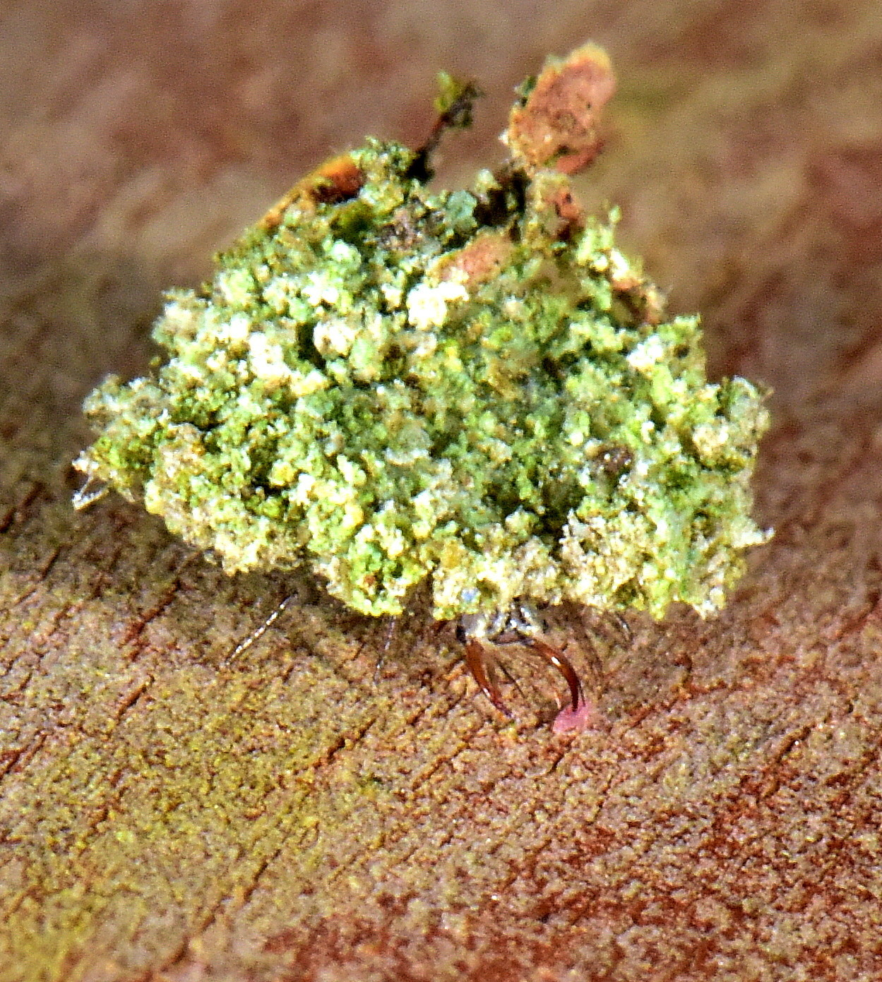
Importance of lichen
food, shelter, and building materials for many animals and insects
  some insects have evolved to look like lichen or glue lichen to their back as defense
  Humans use lichen for dyes, clothing, and decoration
    Indigenous cultures use some lichen for food and medicinal purposes
  Be careful, not all lichen are edible + some can be poisonous.
Yes! I’m a bug hiding under this cloak of lichens!

Slide 5
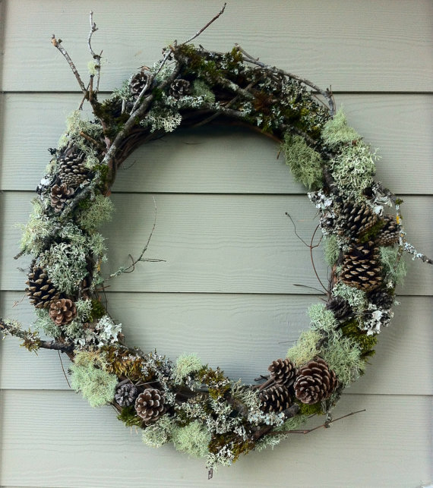
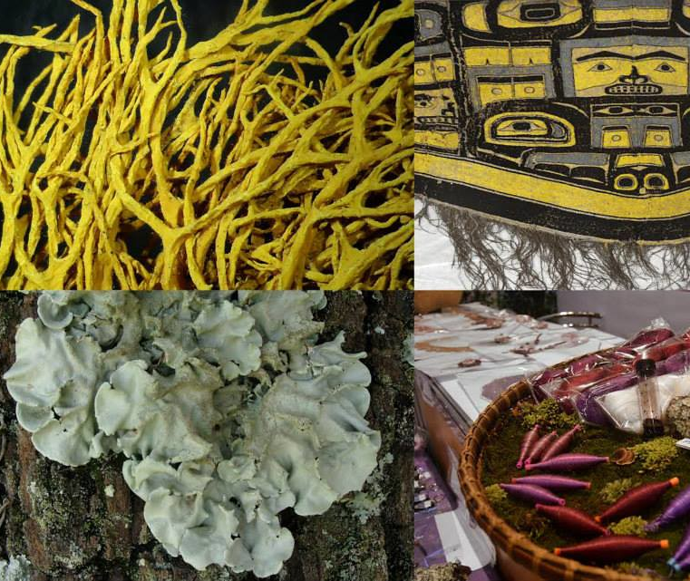
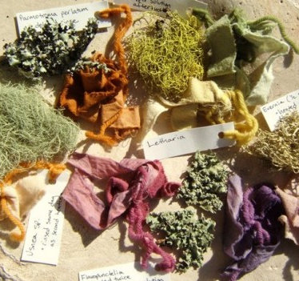
https://fibershed.org
https://www.etsy.com/ca/listing/219793004/
https://www.flickr.com/photos/fieldmuseum/15136046401

Slide 6
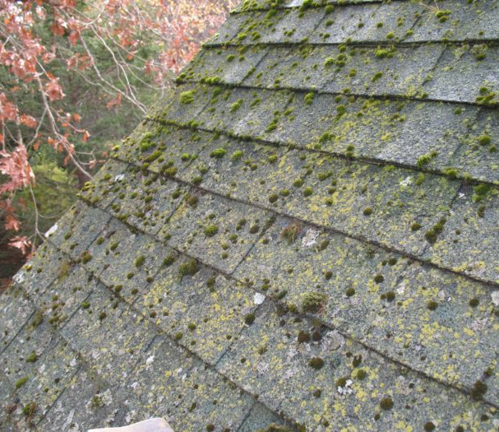
Where are lichen found?
Trees
Rocks
Soil
Houses (roofs, decks, siding)
Almost any substrates
  They do not require roots for moisture, so they can be found in very unlikely places!

Slide 7
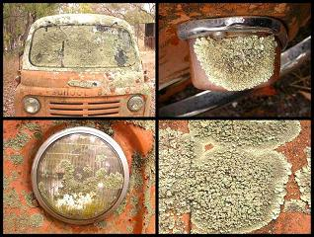
Even on this old school bus!
https://www.anbg.gov.au/lichen/ecology-substrates.html

Slide 8
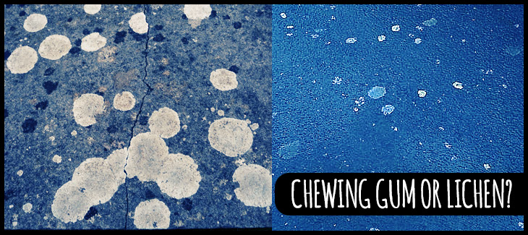
Some lichen look like chewing gum on the pavement!
https://untamedscience.com/biodiversity/lichens/

Slide 9
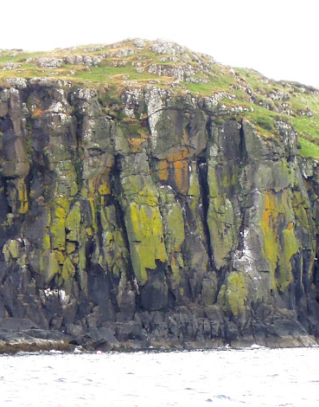
Where are lichen found locally?
In the forest:
  Tree trunks
  Rocks
Urban areas:
  Thin and sandy soils
  Pavement
Coastal Areas:
  Rocks in the splash zone
Probably on your house or in your backyard!
http://www.lichens.lastdragon.org/Caloplaca_verruculifera.html

Slide 10
Great Intro to Lichen
VIDEO: Introduction to Lichen (https://www.youtube.com/watch?v=4_cgm6kh0ns)
  Pause the video at 2:06 ☺ We will pick it up again later!

Slide 11
Let’s Go Learn About Lichen!
Body of lichen is called the ‘Thallus’
The shape of lichens helps us to categorise into groups. In this lesson we will study about three categories of lichen…

Slide 12
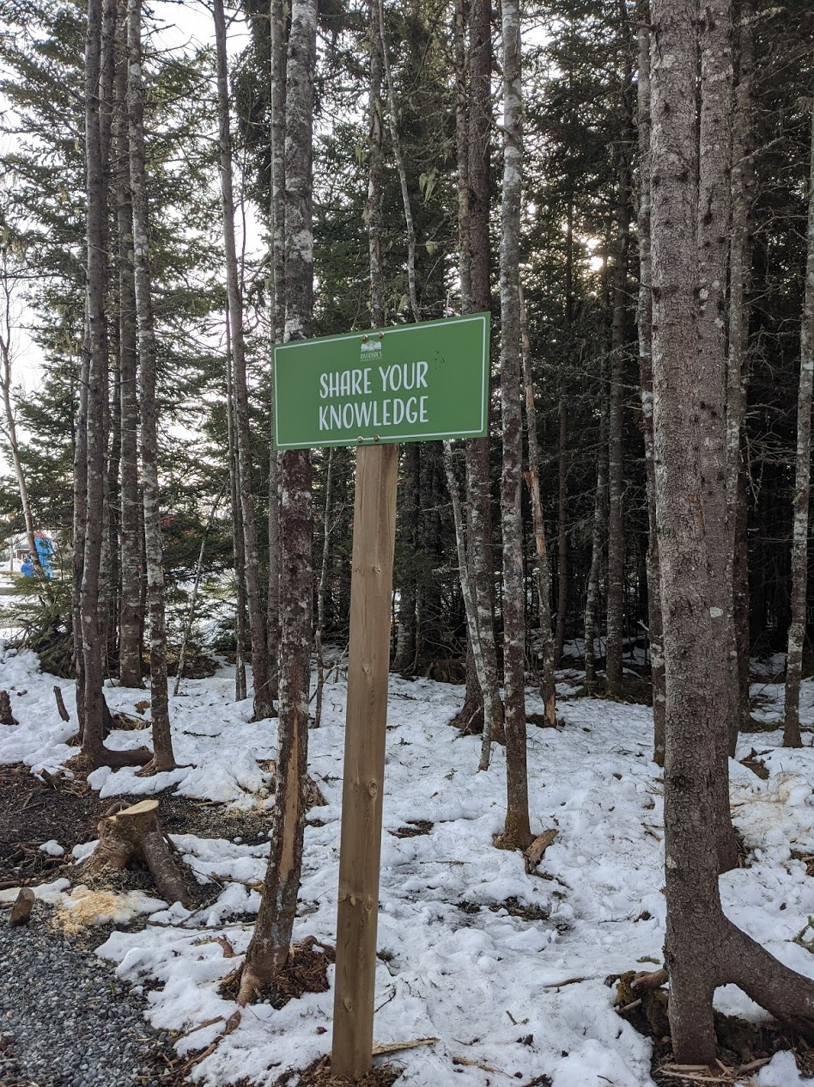
Happy Exploring!

Slide 13
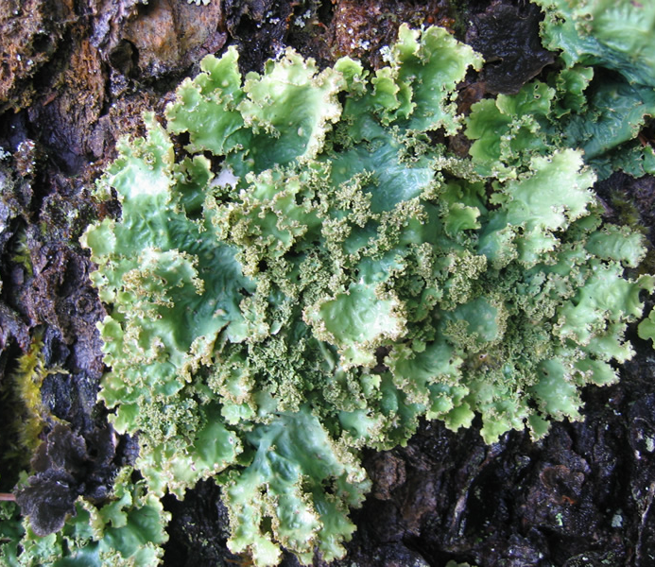
Foliose lichen
‘Foliosus’ means leafy in Latin
Foliose lichen have two easily distinguishable sides
  i.e. a top side and a bottom side
They can be very flat, leafy like lettuce, or convoluted and full of ridges and bumps
  This one looks like kale!

Slide 14
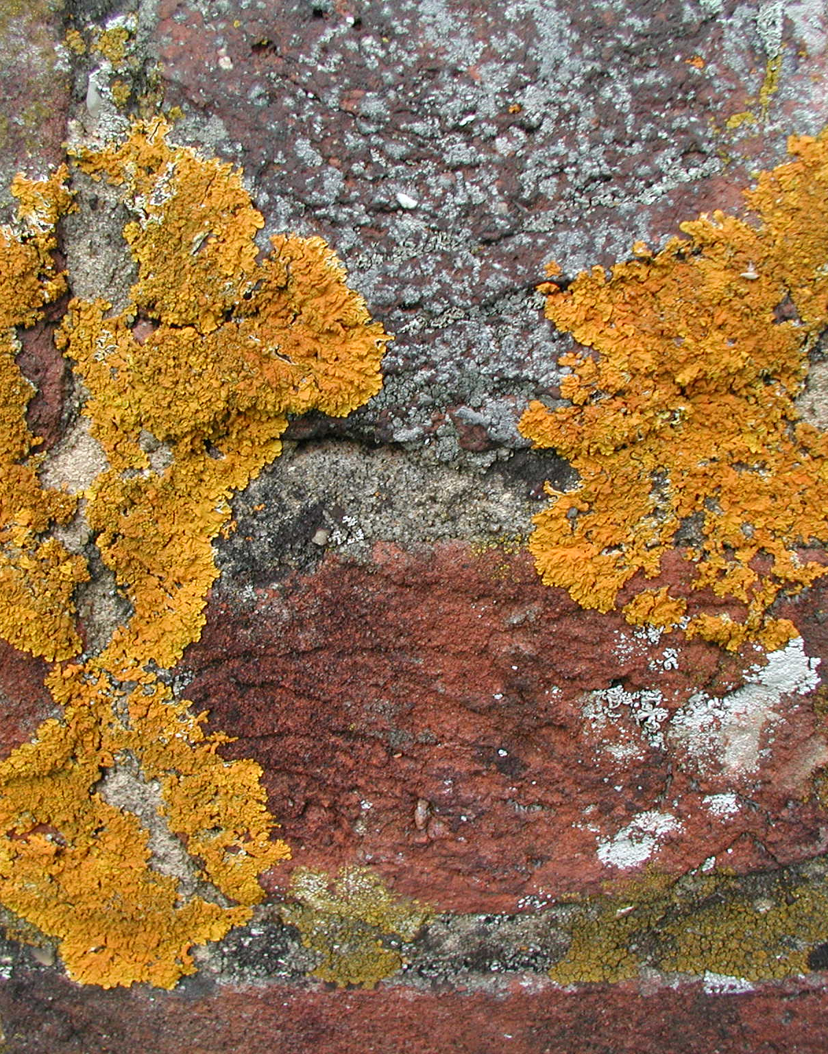
Crustose lichen
‘Crustose’ means crusted
They form a crust over surfaces, like a boulder, soil, a car, or your roof
They come in many bright, vibrant colors like sunny yellow, orange, and red, as well as grays and greens
Crustose lichen are pressed against their substrate

Slide 15
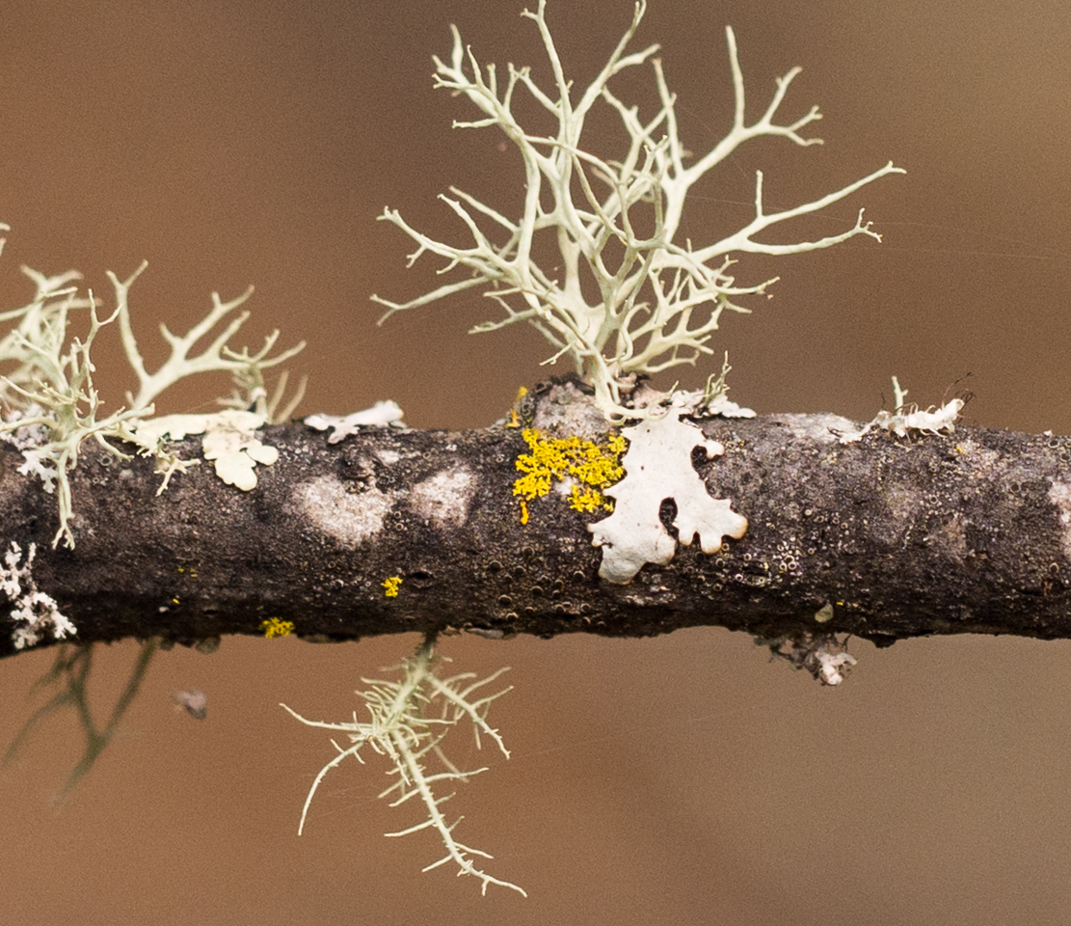
Fruticose lichen
‘Fruticose’ means shrub-like
They can be pendant and hair-like, upright and shrubby, or upright and cup-like
Many have round branches
  With a core or hollow
Other fruticose lichen have flat branches that tangle up with each other
  e.g. the beard lichen
https://commons.wikimedia.org/wiki/File:Fruticose_lichen_(01902).jpg

